Slide 1
Sentinel lymph node detection Camelyon16
Jeswanth Yadagani
jy3012

Slide 2
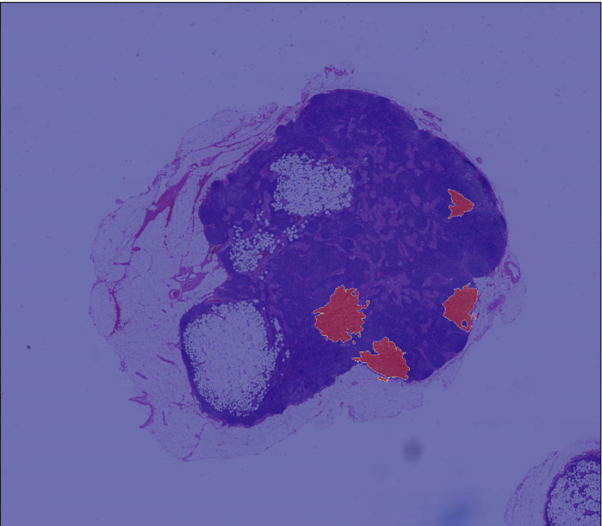
Data Organization
18 Train Slides + 3 Test Slides
Positive if mask is present
Train Slices
Level 3
Level 4
positive
negative
positive
negative
Combined Positive
Combined Negative

Slide 3
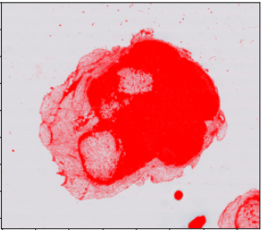
Remove Background from Train and Slice
Slice Size - 299 x 299
Slices are rejected if amount of tissue is lower than 10%
 | With Background |  | Without Background
 | Negative | Positive | Negative | Positive
Level 3 | 51288 | 671 | 6925 | 671
Level 4 | 12615 | 263 | 1636 | 263
Total | 63903 | 934 | 8561 | 934

Slide 4
Balance Dataset
Randomly select 2*(No. of positive) images from negative class
 | Before Balancing |  | After Balancing
 | Negative | Positive | Negative | Positive
Level 3 | 6925 | 671 | 1342 | 671
Level 4 | 1636 | 263 | 526 | 263
Total | 8561 | 934 | 1868 | 934

Slide 5
Models
Baseline CNN
Transfer Learning with Inception V3
Transfer Learning with Inception V3 with weights from scratch
Inception V3 with weights from scratch and data augmentation
Multi-level Model

Slide 6
Model Comparison - Precision and Recall on tumor_96
 |  | Precision | Recall
Level 4 | Baseline | 0.93 | 0.31
 | Inception V3 (imagenet) | 0.49 | 0.53
 | Inception V3 (scratch) | 0.90 | 0.5
Level 3 | Inception V3 (scratch) | 0.99 | 0.67
 | Inception V3 (scratch + data aug) | 0.91 | 0.88
Multi-level | Inception V3 (scratch) | 0.69 | 0.88

